Slide 1

Mini Project On -
Essential Locations Near You
By - Anurag V Kulkarni 43 & Abhinav Tripathy 15
Guided By - Mrs. Vibha Pandey

Slide 2

INTRODUCTION
WORKING
CONTENTS
PROJECT
OUTCOME

Slide 3

1
lntroduction

Slide 4
lntroduction
About our project,
This project uses HTML,CSS,Figma,PHP and javascript.
Essential Locations Near You is a simple project in HTML,CSS,PHP,Figma and javascript .This is an interesting project .The project contains only admin side .The project is for Spreading Knowledge around pepole.This project uses CRUD operation for the management system like adding deleting and updating data

Slide 5

2
Working

Slide 6
Working
HTML
PHP
Structural support to web page
For Diffrent Operations in Web Page
Outcome
Project On Essential Locations Around you
CSS
Figma
Styling and Arranging Elements in web page
To add grapical (Visual) elements to web page

Slide 7
Working
HTML (HyperText Markup Language) used to structure a web page and its content. For example, content could be structured within a set of paragraphs, a list of bulleted points, or using images and data tables
CSS (Cascading Style Sheets) used to style and layout web pages — for example, to alter the font, color, size, and spacing of your content, split it into multiple columns, or add animations and other decorative features
Figma is a powerful design tool used to create : websites, applications, logos, etc. By learning to use Figma, we can take your first steps into User Interface Design and and User Experience Design

Slide 8
3
Project

Slide 9

lntroduction
About our project,
This project uses HTML,CSS,Figma,PHP and javascript.
Essential Locations Near You is a simple project in HTML,CSS,PHP,Figma and javascript .This is an interesting project .The project contains only admin side .The project is for Spreading Knowledge around pepole.This project uses CRUD operation for the management system like adding deleting and updating data

Slide 10

lntroduction
About our project,
This project uses HTML,CSS,Figma,PHP and javascript.
Essential Locations Near You is a simple project in HTML,CSS,PHP,Figma and javascript .This is an interesting project .The project contains only admin side .The project is for Spreading Knowledge around pepole.This project uses CRUD operation for the management system like adding deleting and updating data

Slide 11
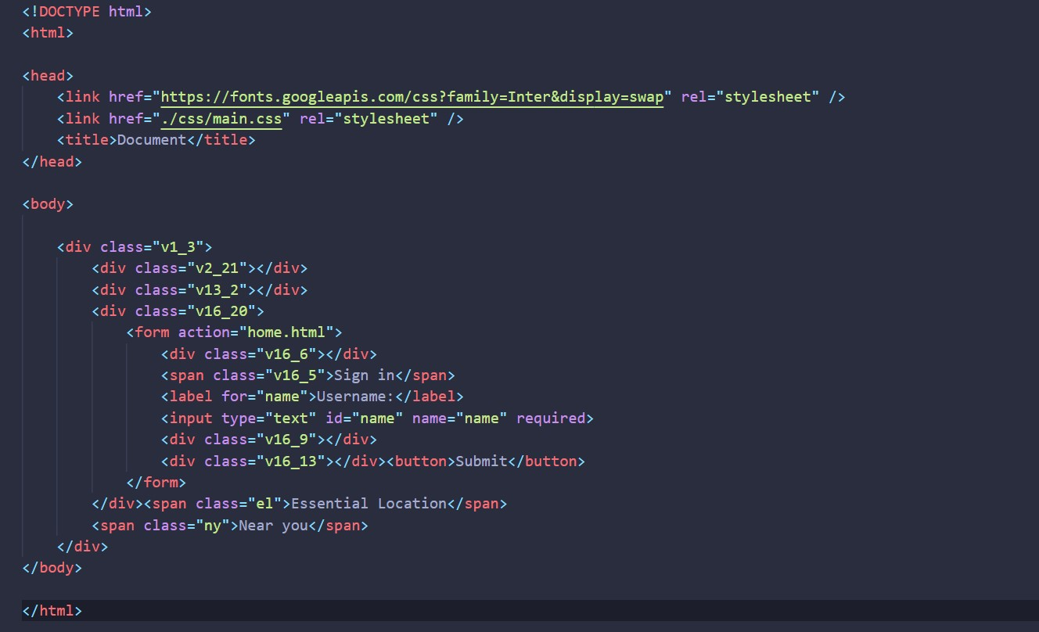
lntroduction
About our project,
This project uses HTML,CSS,Figma,PHP and javascript.
Essential Locations Near You is a simple project in HTML,CSS,PHP,Figma and javascript .This is an interesting project .The project contains only admin side .The project is for Spreading Knowledge around pepole.This project uses CRUD operation for the management system like adding deleting and updating data

Slide 12
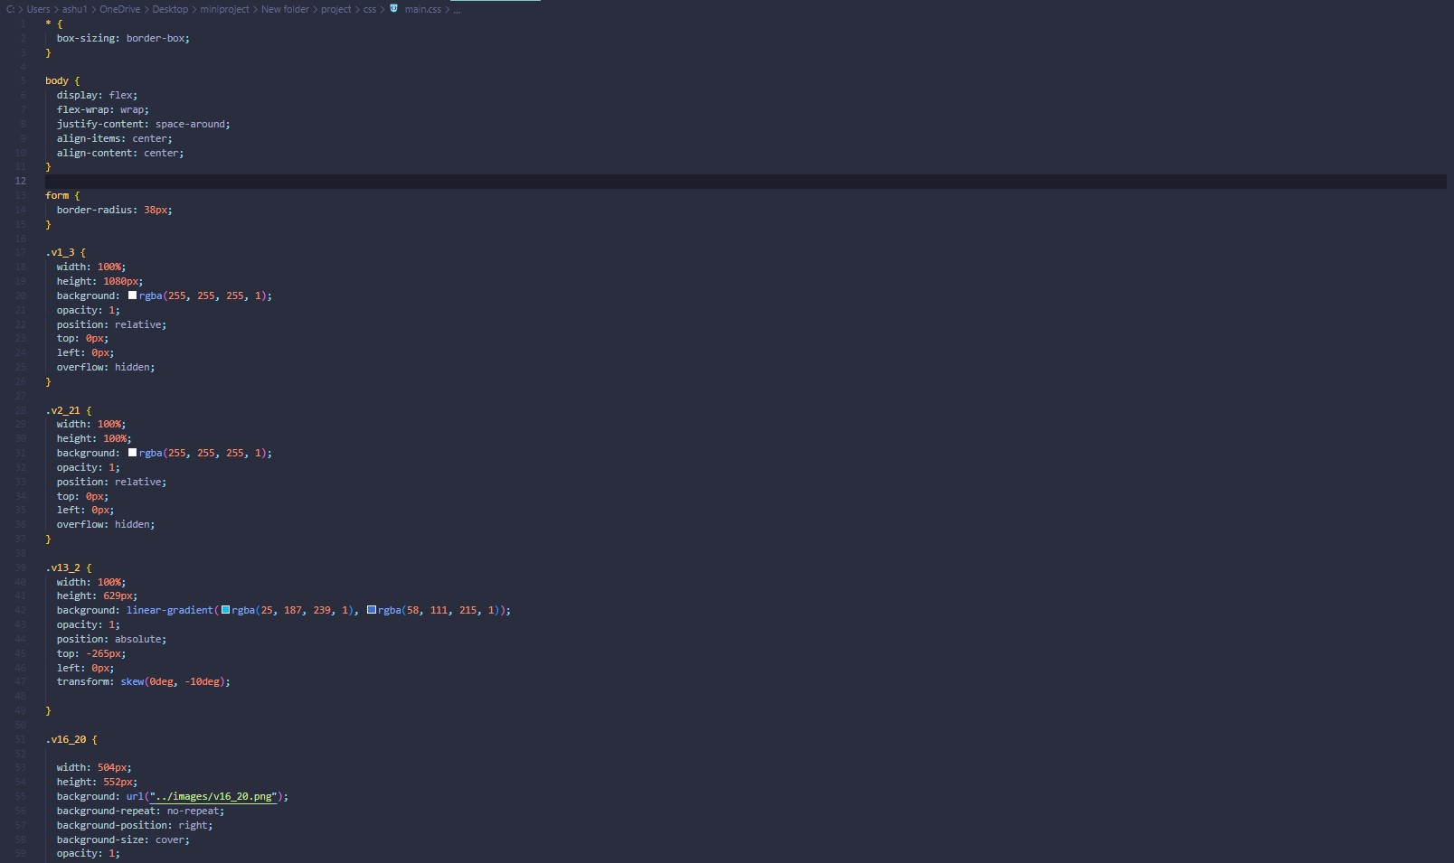
lntroduction
About our project,
This project uses HTML,CSS,Figma,PHP and javascript.
Essential Locations Near You is a simple project in HTML,CSS,PHP,Figma and javascript .This is an interesting project .The project contains only admin side .The project is for Spreading Knowledge around pepole.This project uses CRUD operation for the management system like adding deleting and updating data

Slide 13
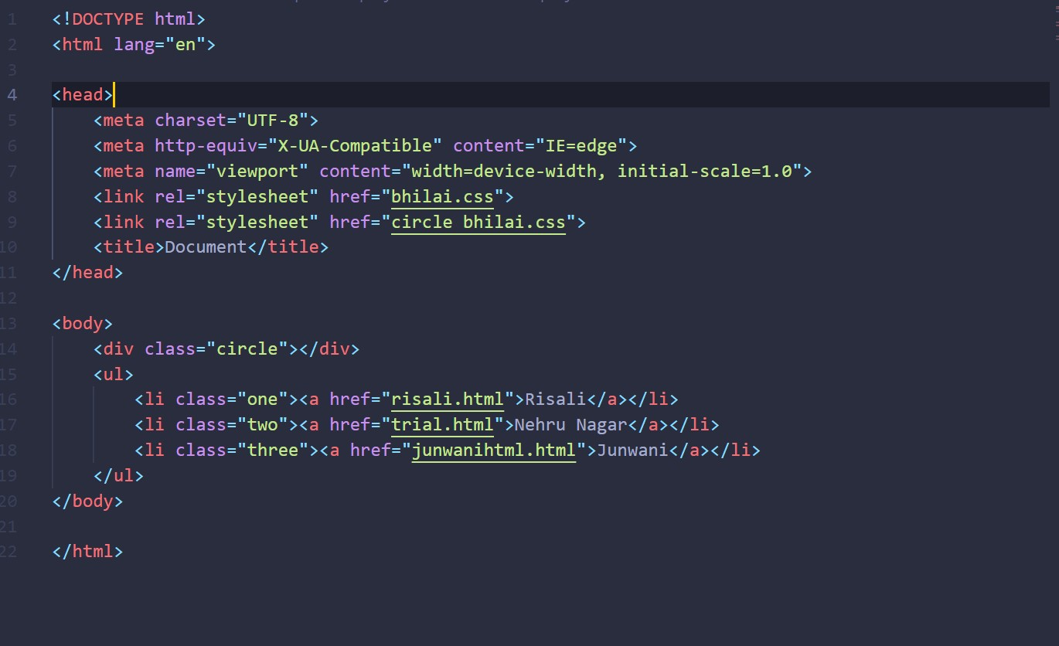
Project
About our project,
This project uses HTML,CSS,Sigma,PHP and javascript.
Essential Locations Near You is a simple project in HTML,CSS,PHP,Sigma and javascript .This is an interesting project .The project contains only admin side .The project is for Spreading Knowledge around pepole.This project uses CRUD operation for the management system like adding deleting and updating data

Slide 14
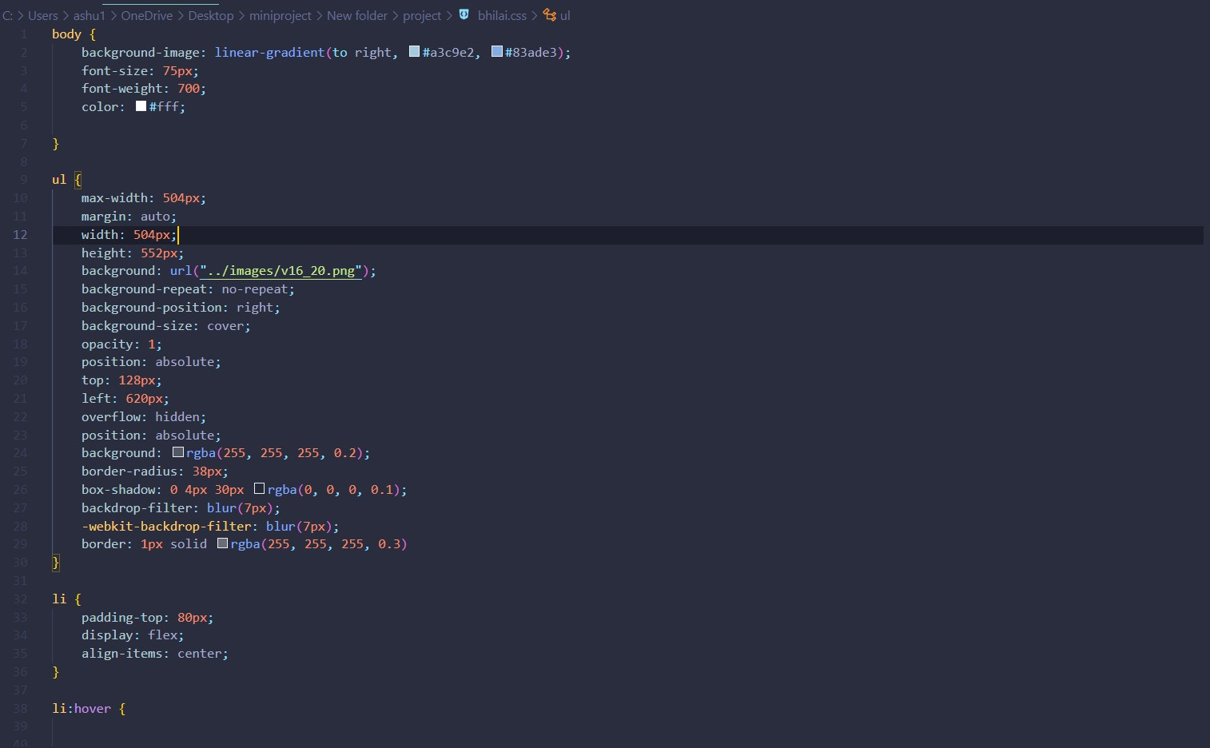
lntroduction
About our project,
This project uses HTML,CSS,Figma,PHP and javascript.
Essential Locations Near You is a simple project in HTML,CSS,PHP,Figma and javascript .This is an interesting project .The project contains only admin side .The project is for Spreading Knowledge around pepole.This project uses CRUD operation for the management system like adding deleting and updating data

Slide 15
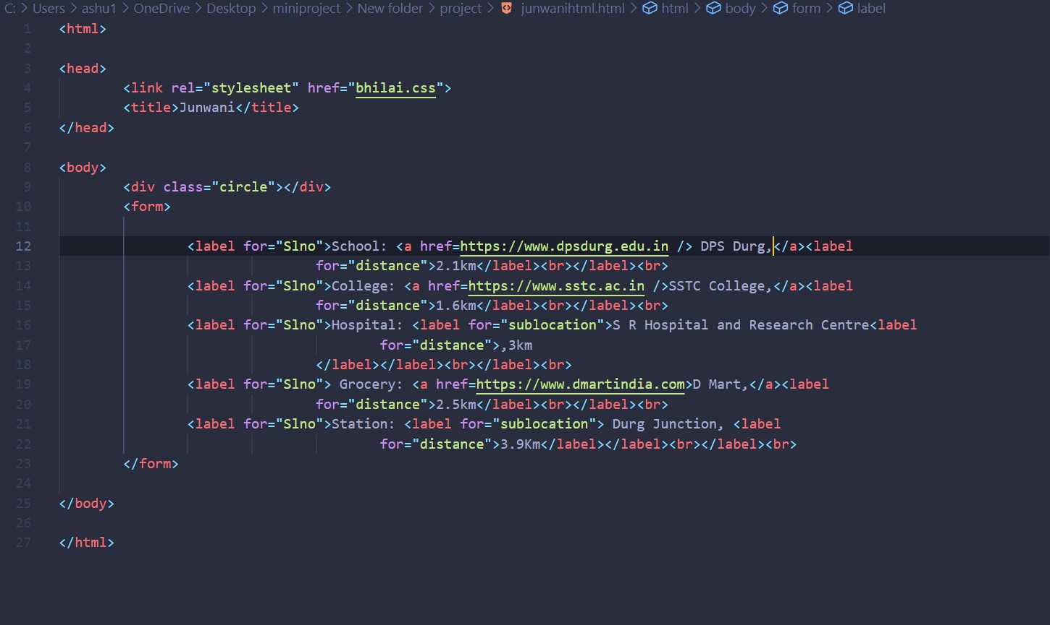

Slide 16
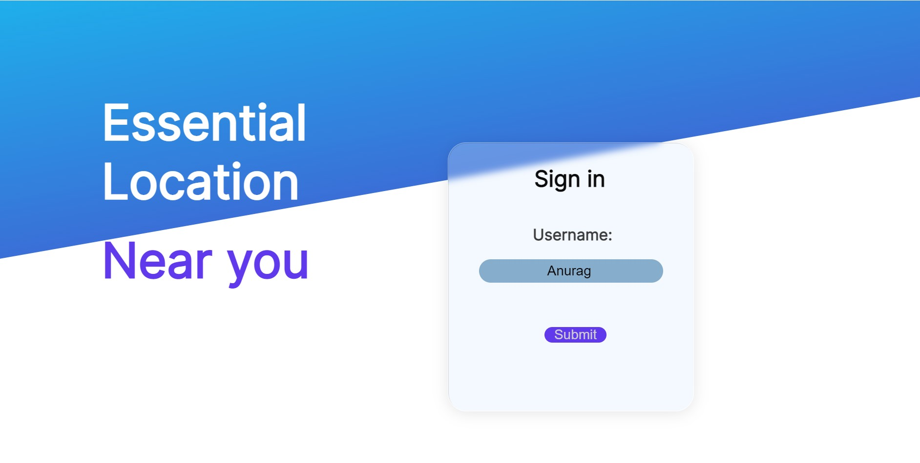

Slide 17

lntroduction
About our project,
This project uses HTML,CSS,Figma,PHP and javascript.
Essential Locations Near You is a simple project in HTML,CSS,PHP,Figma and javascript .This is an interesting project .The project contains only admin side .The project is for Spreading Knowledge around pepole.This project uses CRUD operation for the management system like adding deleting and updating data

Slide 18
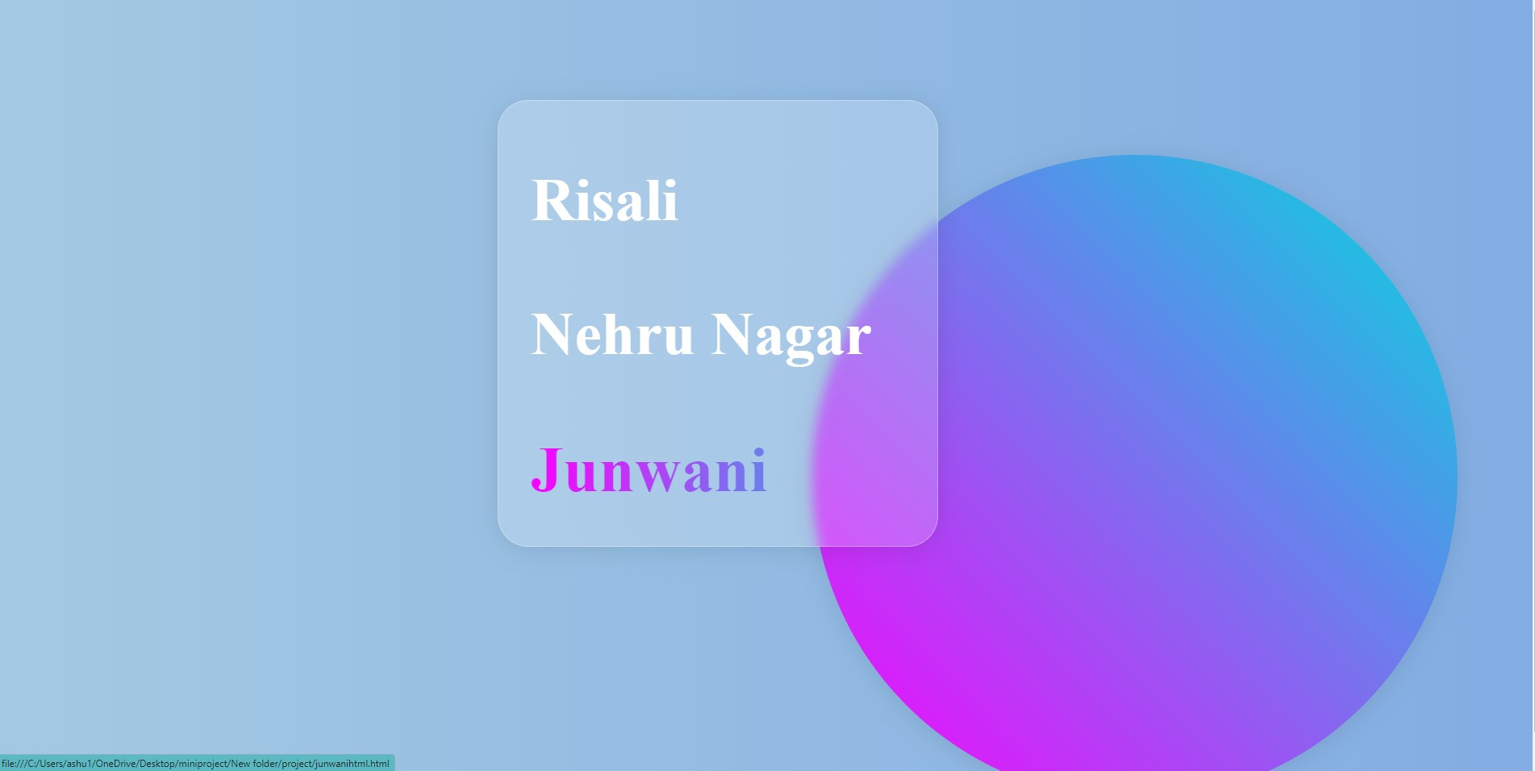
lntroduction
About our project,
This project uses HTML,CSS,Figma,PHP and javascript.
Essential Locations Near You is a simple project in HTML,CSS,PHP,Figma and javascript .This is an interesting project .The project contains only admin side .The project is for Spreading Knowledge around pepole.This project uses CRUD operation for the management system like adding deleting and updating data

Slide 19
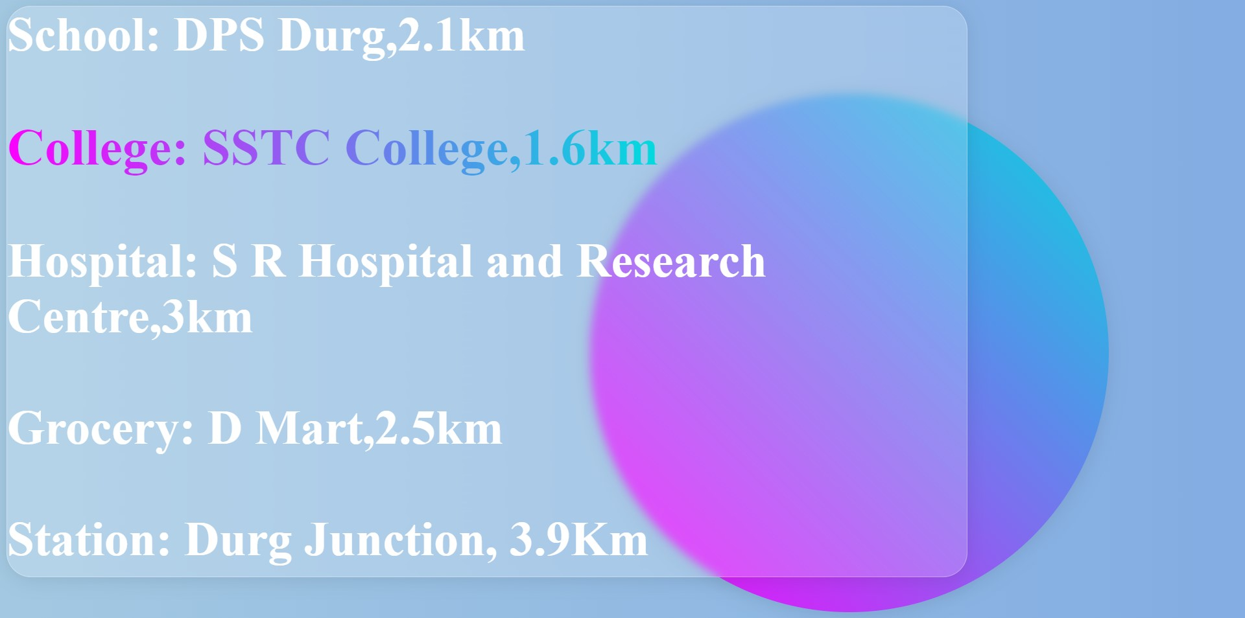
lntroduction
About our project,
This project uses HTML,CSS,Figma,PHP and javascript.
Essential Locations Near You is a simple project in HTML,CSS,PHP,Figma and javascript .This is an interesting project .The project contains only admin side .The project is for Spreading Knowledge around pepole.This project uses CRUD operation for the management system like adding deleting and updating data

Slide 20
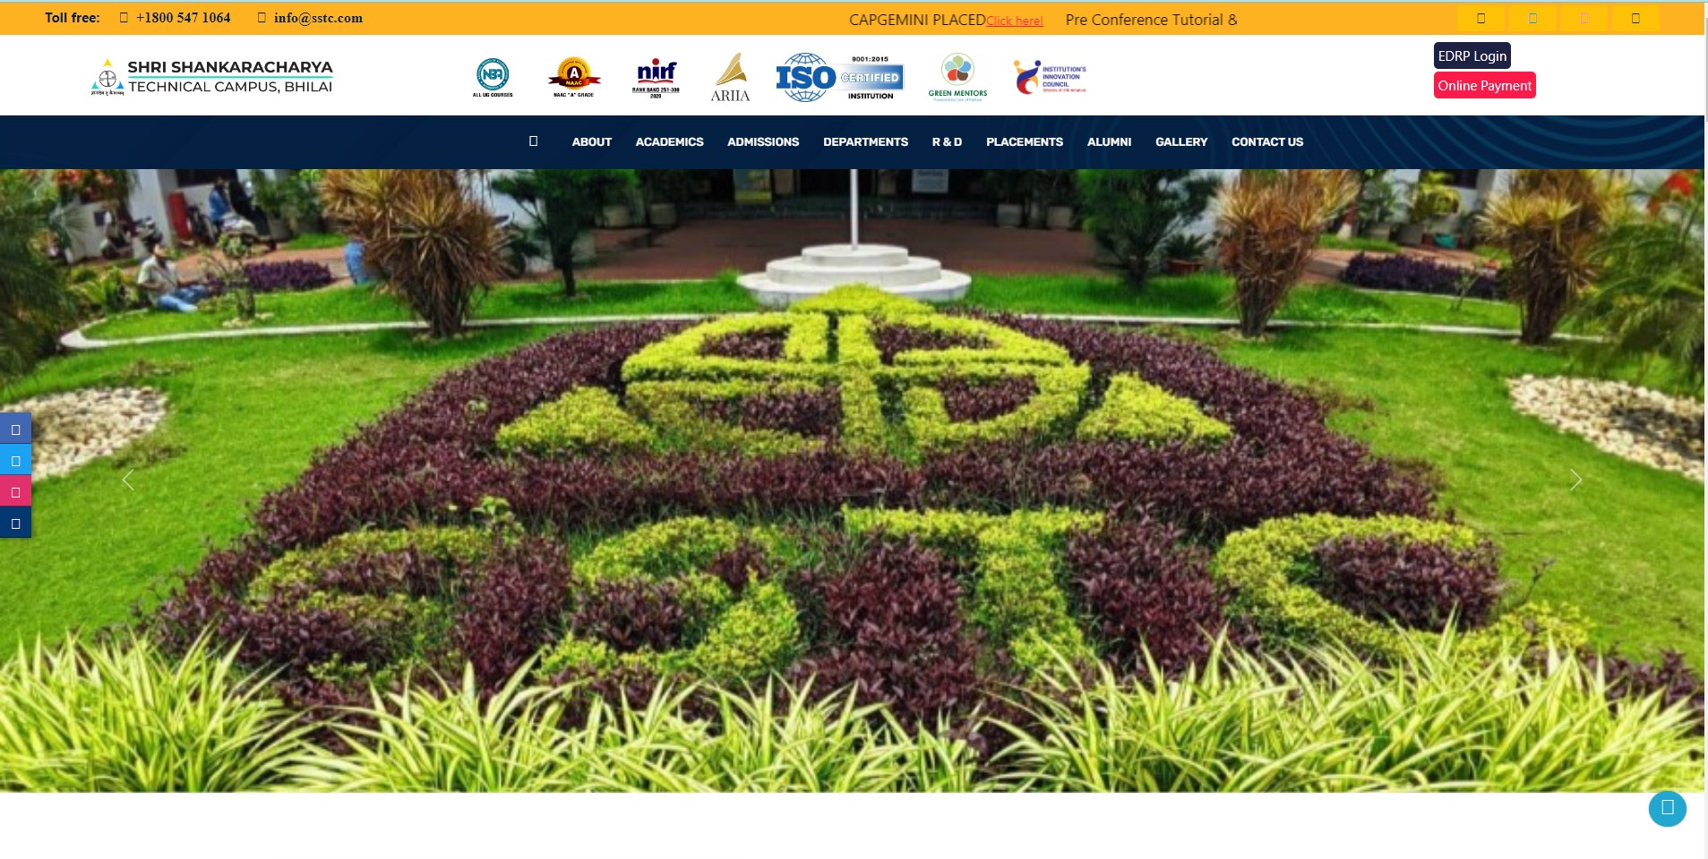
lntroduction
About our project,
This project uses HTML,CSS,Figma,PHP and javascript.
Essential Locations Near You is a simple project in HTML,CSS,PHP,Figma and javascript .This is an interesting project .The project contains only admin side .The project is for Spreading Knowledge around pepole.This project uses CRUD operation for the management system like adding deleting and updating data

Slide 21
4
Outcome

Slide 22
Outcome
Essential locations near you will help in knowing the essential places like School,Colleges,Hospital,Grocery stores,Entertainment and stations near you.
It's saves the time in day to day life as well as in emergency situations
It provides you with the Distance so that you don't have to waste any of your precious time in finding the right location

Slide 23
Conclusion
1
With its rising popularity, more and more Developers are now adopting the information management system.
2
This module streamlines and automates every important location around you with information allotment,website,etc.
3
It helps to spread location awareness quickly as well as accurately.

Slide 24
Any Queries ?

Slide 25
THANK YOU

